Slide 1
use case model
csc 131 - dream team

Slide 2
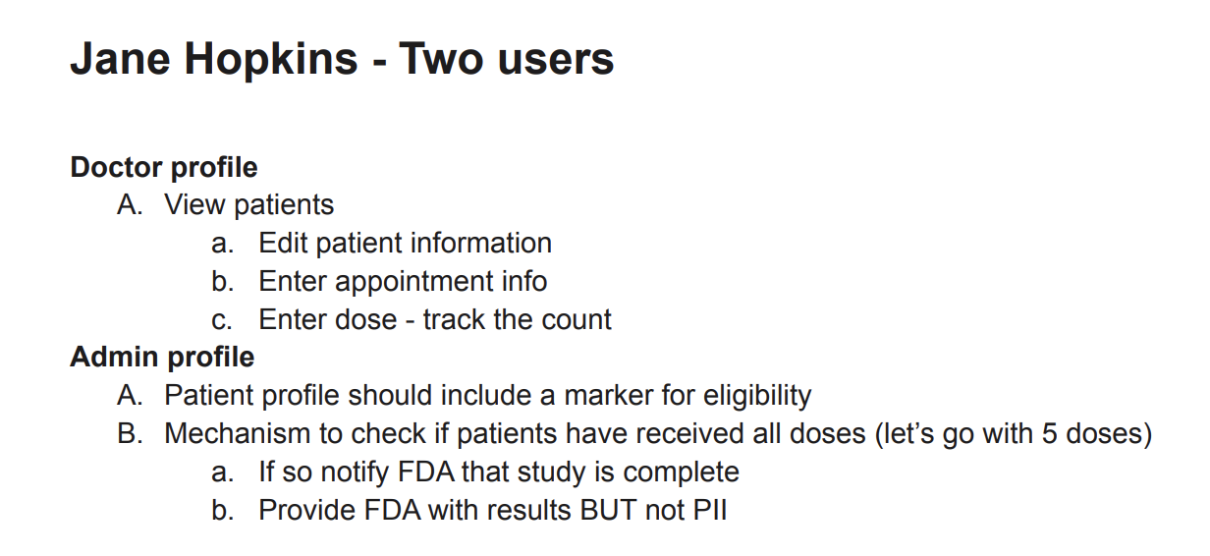
Jane Hopkins
Actors:
Patient Info (smart contract)
Passenger:
Edit data
<<extend>>
View patient data
<<extend>>
If End Trial (placebo vs drug)
Log in
Doctor
<<extend>>
FDA
Dosage
Patient eligibility check
Admin
Notify FDA
Check Doses
<<extend>>

Slide 3
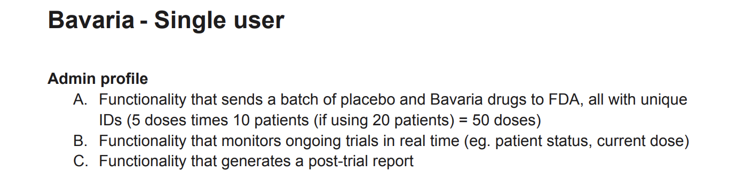
Bavaria
Actors:
Placebo & Bavaria Drugs
Passenger:
Send Drugs (Labeled) to FDA
FDA
Log in
Monitor Ongoing Trials
Admin
Post-trial report

Slide 4
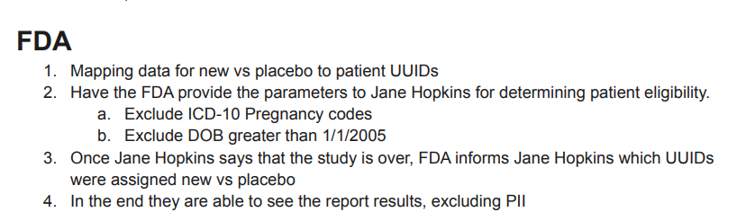
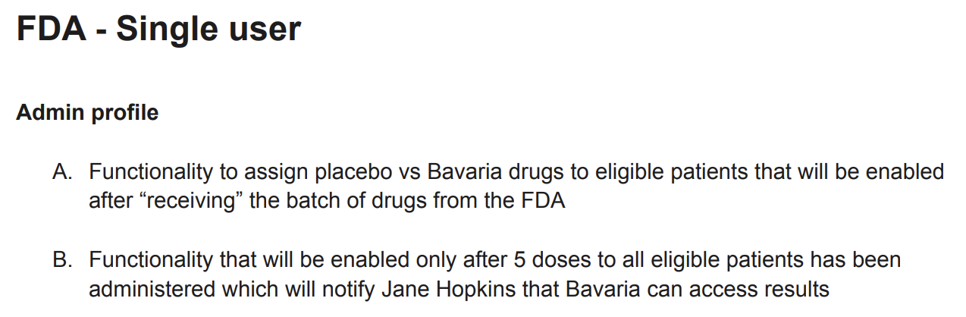
FDA
Patient data (smart contract)
passenger:
actors:
Assign placebo vs Bavaria drugs
<<extend>>
Jane Hopkins
Log in
FDA Admin
Map data for new vs placebo to patient UUIDs
(Gives eligibile patients drugs)
<<extend>>

Slide 5
Blood Type
Date_of_Birth
Weight
Patient Picture
Height
Drug ID
uuid
doseNum
Address
ICD Health Codes
F_Name
Study ID
crrentlyEmployed
JH_Doctor
L_Name
Insurance Number
getsAndEdits_Data
Blood Pressure
Oxygen Saturation
Patient
Family History
isEligible
edit_Data
Temperature
JH_Admin
currentlyInsured
Get data besides PII
reports_Data
Bavaria
Get study/drug data
FDA
Notes:
Bavaria and fda on separate slide to see after trial results
On vendia - attributes and relationships too

Slide 6
JH Doctor
FDA
Add Patient Appointments
Enter/Edit Patient Data
Check on the Trial
Receive the End of Trial Report
Dream Team’s Website
Administer and Assign Drug/Placebo to Patients
Check on Patient Appointments
Monitor Trial Progress
Bavaria
JH Admin
Notes:
System context diagram (SCD)

Slide 7
JH Doctor
Header and Logo
Profile Menu
Add Patient Button
Add Appt Button
Table Filter Options
Patient Table
Notes:
System context diagram (SCD)

Slide 8
JH Admin
Header and Logo
Profile Menu
Increase Doses +1
Increase Doses +5
Table Filter Options
Patient Table
Notes:
System context diagram (SCD)

Slide 9
Bavaria
Header and Logo
Profile Menu
Create Study
Study Table
Table Filter Options
Patient Table
Notes:
System context diagram (SCD)

Slide 10
FDA
Header and Logo
Profile Menu
Create Study
Study Table
Notes:
System context diagram (SCD)

Slide 11
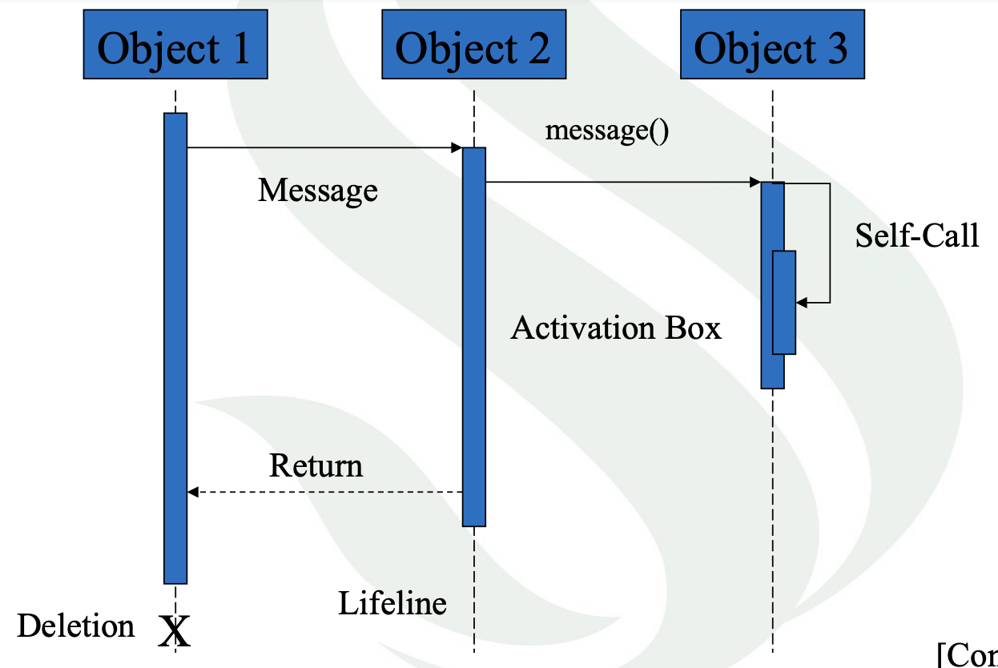
Doctor: Patient Table
Vendia Database
Vendia Database
Enter Appointment Info, Dosage, Notes
Update Database Fields
Edit Patient Info
Return:
Updated Patient Info
Return:
Updated Patient Info
Delete Patient
Notes:
Sequence diagram

Slide 12
FDA: Study Table
Bavaria: Study Table
Vendia Database
Create Study
Update Database Fields
FDA Approve Study
Bavaria Approve Study
Send Drugs to FDA
Assign Drugs to Patients
Return: Study Status
Return:
Study Status
Delete Study
Notes:
Sequence diagram

